Slide 1
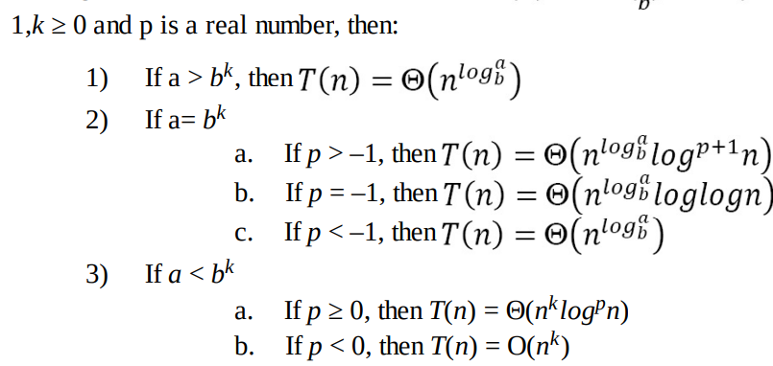
MASTER THEOREM

Slide 2
MASTER THEOREM
Link to some problems related to master theorem:
https://docs.google.com/document/d/1jUJNTigdska_ywpzk_-w6TKqUsPSqQ7H1IgIPyU2eAI/edit?usp=sharing

Slide 3
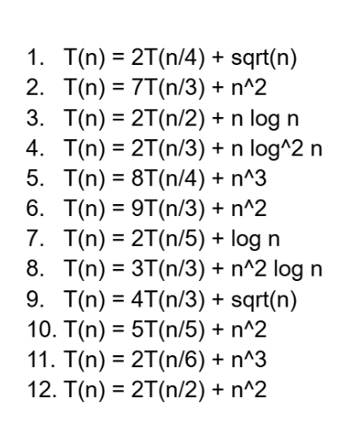
MASTER THEOREM

